Slide 1
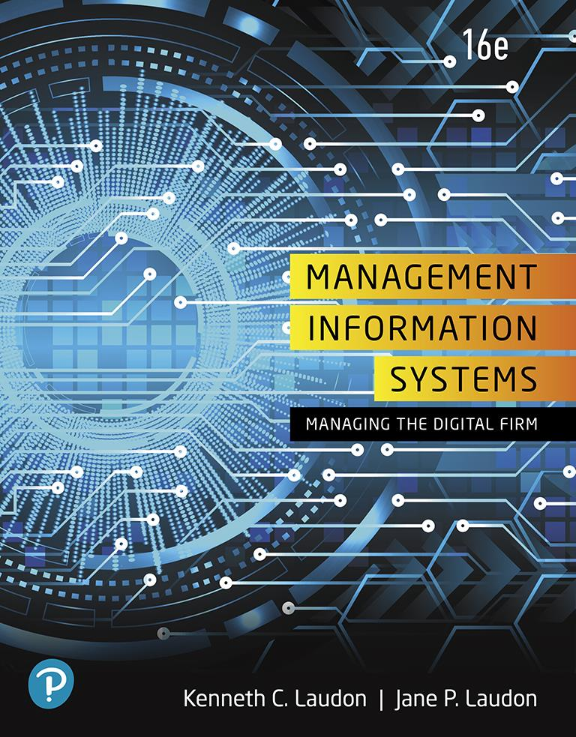
Management Information Systems: Managing the Digital Firm
Sixteenth Edition
Chapter 7
Telecommunications, the Internet, and Wireless Technology
Slide in this Presentation Contain Hyperlinks. JAWS users should be able to get a list of links by using INSERT+F7
Copyright © 2020, 2018, 2016 Pearson Education, Inc. All Rights Reserved
Notes:
If this PowerPoint presentation contains mathematical equations, you may need to check that your computer has the following installed:
1) MathType Plugin
2) Math Player (free versions available)
3) NVDA Reader (free versions available)

Slide 2
Learning Objectives
7.1 What are the principal components of telecommunications networks and key networking technologies?
7.2 What are the different types of networks?
7.3 How do the Internet and Internet technology work, and how do they support communication and e-business?
7.4 What are the principal technologies and standards for wireless networking, communication, and Internet access?
7.5 How will M I S help my career?
Notes:
This chapter discusses the principle technologies used in networking and the Internet. Ask students what the difference is between a network and the Internet. Why is networking so important to modern organizations? How many students have wireless networks at home? How many have a smartphone that uses a 3G or 4G network? What's the difference between a 4G network and Wi-Fi? How many students have seen an RFID tag?

Slide 3
Video Cases
Case 1: Telepresence Moves out of the Boardroom and into the Field
Case 2: Virtual Collaboration with I B M Sametime

Slide 4
Tour de France Wins with Wireless Technology (1 of 2)
Problem
Omnichannel retail strategy
Inventory inaccuracy
Solutions
Revise race tracking processes
Obtain external data
Tracking sensors
Mobile app
Cloud computing service
Data analytics
Social media

Slide 5
Tour de France Wins with Wireless Technology (2 of 2)
Wireless Race Tracking System
Demonstrates illustrates some of the powerful capabilities and opportunities provided by contemporary networking technology.
Illustrates the ability of I T systems to enhance services to customers as well as participants

Slide 6
Networking and Communication Trends
Convergence
Telephone networks and computer networks converging into single digital network using Internet standards
Broadband
More than 76 percent U.S. Internet users have broadband access
Broadband wireless
Voice, data communication are increasingly taking place over broadband wireless platforms
Notes:
This slide discusses recent developments in networking technologies. Ask students to give an example of convergence. How fast is broadband today? Note that in 2000, typical Internet access speeds were 56 kbps over a telephone line, costing 25 cents per kilobit, whereas today broadband speeds are 10-50 mbps, costing 1 cent per kilobit (or 10 cents per gigabit). Are students aware of how fast their Internet connections are at home, school, or work? Ask students if they know the speed of their cell phone’s Internet connection. The point here is to try and raise awareness of telecommunications systems among students.

Slide 7
What Is a Computer Network?
Two or more connected computers
Major components in simple network
Client and server computers
Network interfaces (N I C s)
Connection medium
Network operating system (N O S)
Hubs, switches, routers
Software-defined networking (S D N)
Functions of switches and routers managed by central program
Notes:
This slide describes what a network is along with the components that you will find in a simple network (illustrated on the next slide.) Ask students to describe the function of an NIC. What is a connection medium? Ask students to describe the purpose of a hub, switch, and router.

Slide 8
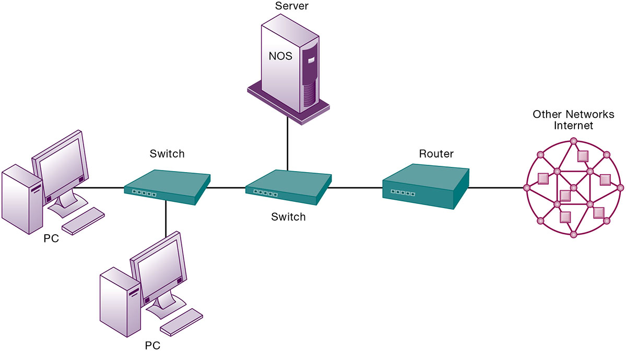
Figure 7.1 Components of a Simple Computer Network
Notes:
Figure 7.1, Page 254.
Illustrated here is a simple computer network consisting of computers, a network operating system (NOS) residing on a dedicated server computer, cable (wiring) connecting the devices, switches, and a router.
Although the NOS is shown as part of the server, note that, depending on the type of software, an NOS may also be designed to reside on client computers (these are called peer-to-peer networks). Do some students have a home computer network? Ask them to describe the elements of the network.

Slide 9
Networks in Large Companies
Hundreds of local area networks (L A N s) linked to firm-wide corporate network
Various powerful servers
Website, corporate intranet, extranet
Backend systems
Mobile wireless L A N s (Wi-Fi networks)
Videoconferencing system
Telephone network, wireless cell phones
Notes:
This slide looks at the additional components one might expect to find in the network of a large company that has many locations and thousands of employees (illustrated on the next slide). Ask students what is meant by “backend systems.” Note that many firms are dispensing with traditional landline telephone networks and using Internet telephones that run on existing internal data networks and the Internet.

Slide 10
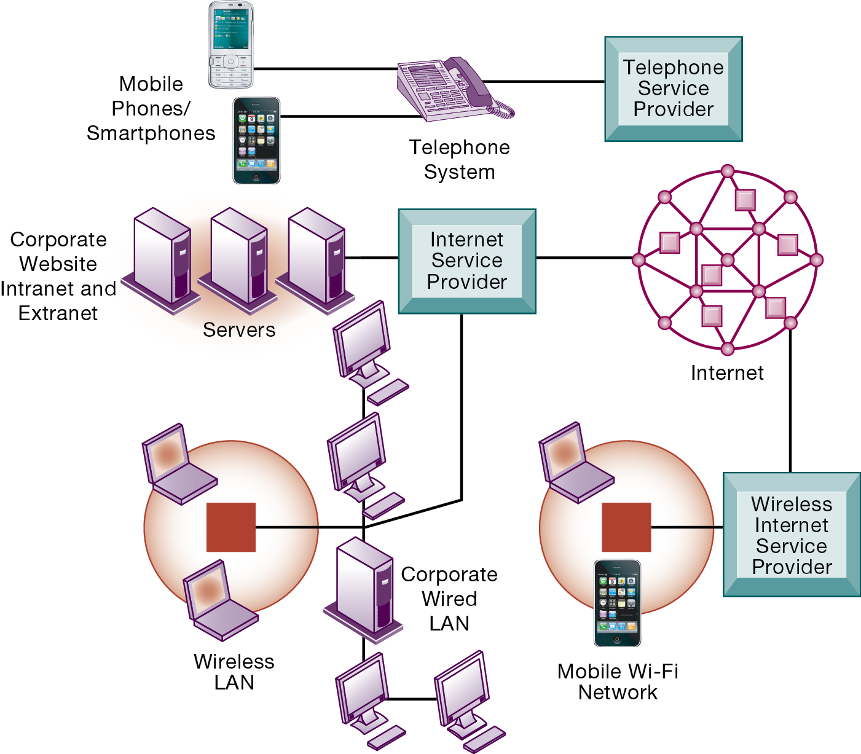
Figure 7.2 Corporate Network Infrastructure
Notes:
Figure 7.2, Page 256.
Today’s corporate network infrastructure is a collection of many networks from the public switched telephone network, to the Internet, to corporate local area networks linking workgroups, departments, or office floors.
This graphic illustrates the components of a large company’s network. Note the difference between the wireless LAN, which allows wireless access within the office, and the mobile Wi-Fi network, which allows Internet access to employees outside of offices. The advantage of telephone-based wireless systems is that they do not require a Wi-Fi hotspot to work, and in fact can connect users to the entire globe through their telephone networks. Cable networks—major competitors of telephone company Internet providers—have recently developed a mobile option. Optimum Cable (Comcast) has installed neighborhood Wi-Fi hot spots, allowing cable subscribers wireless access to the Internet.
Full description: In the diagram, the telephone service provider is connected to the corporation’s telephone system, which connects to mobile phones and smartphones. The corporate web site, intranet, and extranet are connected to the Internet service provider through the corporation’s servers. The corporate wired L A N and wireless L A N also connect to the Internet service provider. The corporation accesses the Internet through both its Internet service provider and wireless Internet service provider, which provides a mobile WiFi network.

Slide 11
Key Digital Networking Technologies (1 of 3)
Client/server computing
Distributed computing model
Clients linked through network controlled by network server computer
Server sets rules of communication for network and provides every client with an address so others can find it on the network
Has largely replaced centralized mainframe computing
The Internet: largest implementation of client/server computing
Notes:
This slide and the following two look at the main technologies in use today for networks: client/server computing, packet switching, and TCP/IP. Ask students what advantages client/server computing has over centralized mainframe computing.

Slide 12
Key Digital Networking Technologies (2 of 3)
Packet switching
Method of slicing digital messages into parcels (packets), sending packets along different communication paths as they become available, and then reassembling packets at destination
Previous circuit-switched networks required assembly of complete point-to-point circuit
Packet switching more efficient use of network’s communications capacity
Notes:
This slide continues the discussion of the three main networking technologies today, looking at the second, packet switching. Note that circuit-switched networks were expensive and wasted available communications capacity—the circuit had to be maintained whether data was being sent or not. It is also important to note that packet switching enables packets to follow many different paths. What is the advantage of this capability? If one path is blocked due to an accident or power failure, the data will automatically be shifted by routers to open paths. However, in truly massive outages like the September 11, 2011 attack on the World Trade Center, nearby metropolitan servers were knocked out, and for a period of several days, Internet access was limited in the New York Metropolitan area. The notion that packet switching networks would survive a nuclear attack is highly unlikely.

Slide 13
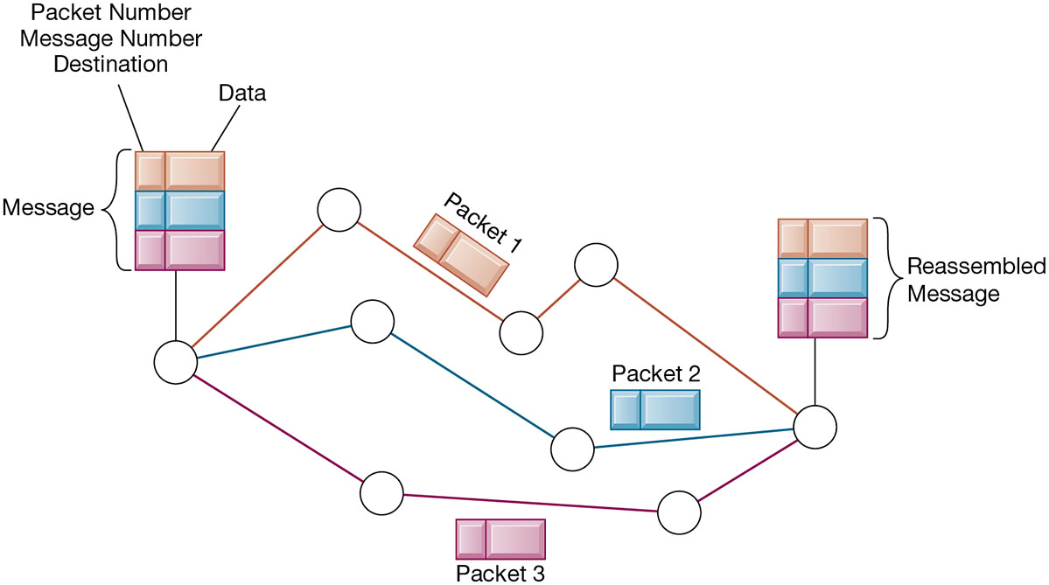
Figure 7.3 Packet-Switched Networks and Packet Communications
Notes:
Figure 7.3, Page 257.
Data are grouped into small packets, which are transmitted independently over various communications channels and reassembled at their final destination.
This graphic illustrates how packet switching works, showing a message being split into three packets, sent along different routes, and then reassembled at the destination. Note that each packet contains a packet number, message number, and destination.

Slide 14
Key Digital Networking Technologies (3 of 3)
T C P /I P and connectivity
Protocols: rules that govern transmission of information between two points
Transmission Control Protocol/Internet Protocol (T C P / I P)
Common worldwide standard that is basis for the Internet
Department of Defense reference model for T C P / I P
Four layers
Application layer
Transport layer
Internet layer
Network interface layer
Notes:
This slide continues the discussion of the three main networking technologies in use today, and looks at the third TCP/IP. Note that in a network, there are typically many different types of hardware and software components that need to work together to transmit and receive information. Different components in a network communicate with one another only by adhering to a common set of rules called protocols. In the past, many diverse proprietary and incompatible protocols often forced business firms to purchase computing and communications equipment from a single vendor. But today, corporate networks are increasingly using a single, common, worldwide standard called Transmission Control Protocol/ Internet Protocol (TCP/IP). TCP/IP actually is a suite of protocols, the main ones of which are TCP and IP. Ask students what these two main protocols are responsible for.

Slide 15
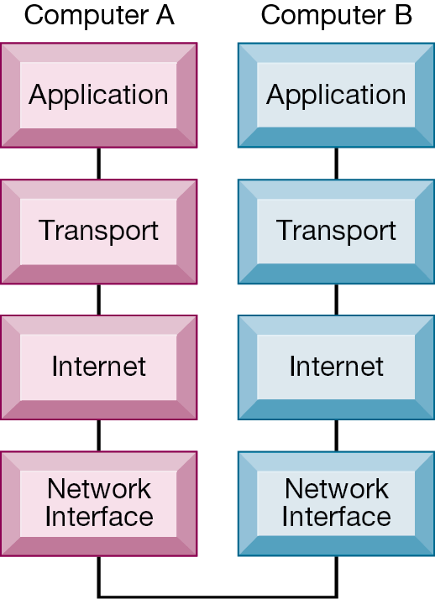
Figure 7.4 The Transmission Control Protocol/Internet Protocol (T C P/I P) Reference Model
Notes:
Figure 7.4, Page 258.
This graphic illustrates the four layers of the DOD reference model for TCP/IP. Note that what happens, when computer A sends a message to computer B, is that the data that computer A creates is transferred within that computer from the application layer to subsequent layers in sequence. In this process it is split into packets, and information is added at each stage, ultimately translating the packets into a form that can be transferred over the network interface. After traveling over the network interface, the packets are reassembled at the recipient computer, from the network interface layer up, ultimately for use by the application layer.
Full description: A Diagram depicts transmission control protocol. According to Transmission Control Protocol, or Internet Protocol, the transmission begins at Computer A with an application, and then proceeds through the transport layer to the Internet layer and on to the network interface. At this point, the message moves to the network interface layer of Computer B and begins a reverse course through the Internet, transport, and application layers, and the communication between the two computers is complete.

Slide 16
Types of Networks
Signals: Digital versus analog
Modem: translates digital signals into analog form (and vice versa)
Types of networks
Local area networks (L A N s)
Ethernet
Client/server vs. peer-to-peer
Wide area networks (W A N s)
Metropolitan area networks (M A N s)
Campus area networks (C A N s)
Notes:
This slide looks at the types of networks that organizations use. Ask students what the differences are between digital and analog signals. Ask students to describe and distinguish between LANs, CANs, WANs, and MANs, and also to talk about their different range of operation. Note that a network can be defined by the way the clients interact (client/server versus peer-to-peer), the type of physical medium to carry signals (Ethernet, Fast Ethernet, etc.), and the way in which computers are connected and send signals to each other (topology).

Slide 17
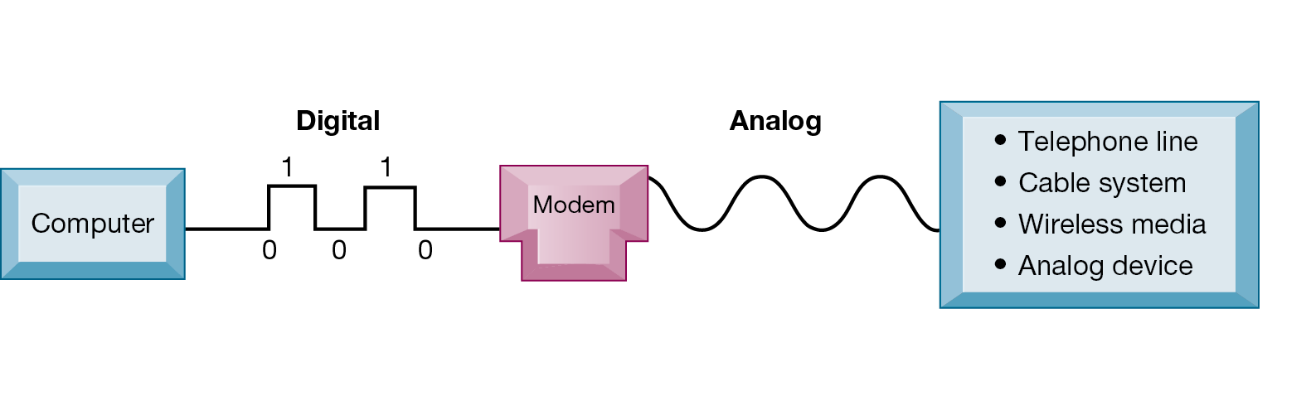
Figure 7.5 Functions of the Modem
Notes:
Figure 7.5, Page 259.
A modem is a device that translates digital signals into analog form (and vice versa) so that computers can transmit data over analog networks such as telephone and cable networks.
This graphic illustrates the differences between digital and analog signals, and shows how digital signals can be sent to other computers over analog cables such as telephone and cable lines which are analog. Note that digital signals are representations of the two binary digits, 0 and 1, and are represented logically as on and off electrical pulses (in reality as different voltages). Ask students what MODEM stands for.

Slide 18
Transmission Media and Transmission Speed
Physical transmission media
Twisted pair wire (C A T5)
Coaxial cable
Fiber optics cable
Wireless transmission media and devices
Satellites
Cellular systems
Transmission speed
Bits per second (b p s)
Hertz
Bandwidth
Notes:
This slide looks at the media involved in network transmission. Note that many of the telephone systems in buildings had twisted wires installed for analog communication, but they can be used for digital communication as well. Also, today, telecommunications companies are starting to bring fiber optic cable into the home for high-speed Internet access.
Note that the transmission capacity of a medium (bps) is dependent on its frequency, which is measured in hertz, or cycles per second. Ask students to define bandwidth (it is the difference between the highest and lowest frequencies that can be accommodated on a single channel).

Slide 19
What is the Internet?
The Internet
World’s most extensive network
Internet service providers (I S P s)
Provide connections
Types of Internet connections
Dial-up: 56.6 K b p s
Digital subscriber line (D S L/F I O S): 385 K b p s –40 M b p s
Cable Internet connections: 1–50 M b p s
Satellite
T1/T3 lines: 1.54–45 M b p s
Notes:
This slide examines what the Internet is—ask students to describe it and what they use it for. The text refers to the Internet as the most extensive public communication system and the world’s largest implementation of client/server computing.

Slide 20
Internet Addressing and Architecture
Each device on Internet assigned Internet Protocol (I P) address
32-bit number, e.g. 207.46.250.119
The Domain Name System (D N S)
Converts I P addresses to domain names
Hierarchical structure
Top-level domains
Notes:
Ask students what an IP address is used for. Ask students why we have a domain name system, and why we don't just use IP addresses. Note that the domain name system makes it possible for people to remember addresses.
Ask students how they connect to the Internet. Do any use satellite? Note that T lines are leased, dedicated lines suitable for businesses or government agencies requiring high-speed guaranteed service levels. Do students know that the Internet does not guarantee any service level, and agrees only to make a “best effort.”

Slide 21
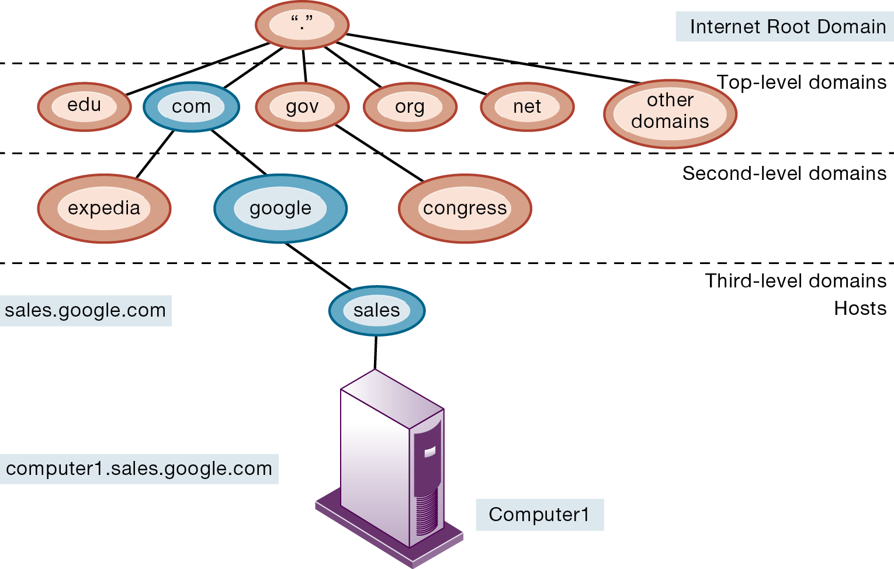
Figure 7.6 The Domain Name System
Notes:
Figure 7.6, Page 263.
Domain Name System is a hierarchical system with a root domain, top-level domains, second-level domains, and host computers at the third level.
This graphic describes how the domain name system works. Note that the “root” domain is the period that is used before the top-level domain, such as .edu or .com. Give students an example Internet address, such as myserver.myspace.com and ask them what the top-, second-, and third-level domains are.
A Diagram depicts the domain name system. In the diagram, the Internet root domain is the highest level of the name system. The top level domains include e d u, com, g o v, org, net, and other domains. Second level domains for dot com include expedia and google. A second level domain for do g o v is congress. A third level domain would include hosts, for example, sales, would be a host at google named sales dot google dot com. The host computer, Computer 1, at this level would be reached at computer 1 dot sales dot google dot com.

Slide 22
Internet Architecture and Governance
Network service providers
Own trunk lines (high-speed backbone networks)
Regional telephone and cable T V companies
Provide regional and local access
Professional organizations and government bodies establish Internet standards
I A B
I C A N N
W 3 C
Notes:
The Internet has many governmental, international, and professional bodies that govern its policies. In addition, many countries have created partially independent domestic Internets that are controlled by government intelligence agencies. The concept of a global Internet is no longer a reality. For instance, the Internet users experience in China or Iran is different from the Internet experienced in the United States, EU, and other Asian countries.

Slide 23
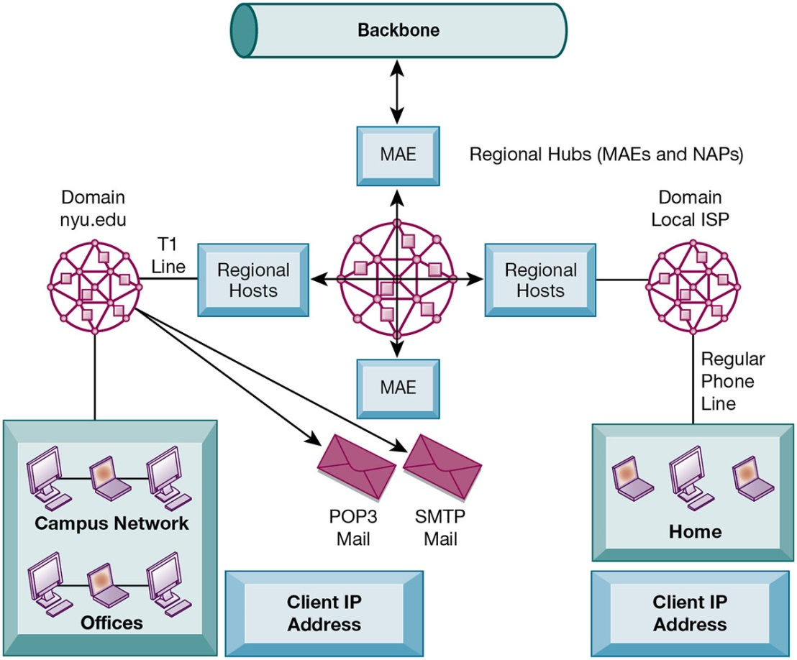
Figure 7.7 Internet Network Architecture
Notes:
Figure 7.7, Page 264.
The Internet backbone connects to regional networks, which in turn provide access to Internet service providers, large firms, and government institutions. Network access points (NAPs) and metropolitan area exchanges (MAEs) are hubs where the backbone intersects regional and local networks and where backbone owners connect with one another.
This graphic illustrates the architecture of the Internet. Note that MAEs (metropolitan area exchanges) are hubs where the backbone intersects regional and local networks and where backbone networks connect with one another.
Full description: A diagram depicts Internet network architecture. At the center of the diagram is the Internet, which connects to various metropolitan area exchanges, or M A E's, and to regional hosts. One regional host includes the domain local I S P and regular phone lines to reach the home of a client I P address. With another regional host, a domain, in this case n y u dot e d u, uses a T 1 line. It reaches its client A P addresses that include offices and a campus network. It also provides mail through POP 3 and S M T P. Regional hubs make use of M A E's and N A P's.

Slide 24
Interactive Session: Organizations: Net Neutrality: The Battle Rages On
Class discussion
What is net neutrality?
Who’s in favor of net neutrality? Who’s opposed? Why?
What would be the impact on individual users, businesses, and government if Internet providers switched to a tiered service model for transmission over landlines as well as wireless?
It has been said that net neutrality is the most important issue facing the Internet since the advent of the Internet. Discuss the implications of this statement.
Are you in favor of legislation enforcing network neutrality? Why or why not?

Slide 25
The Future Internet: I P v 6 and Internet 2
I P v 6
New addressing scheme for I P numbers
Will provide more than a quadrillion new addresses
Not compatible with current I P v 5 addressing
Internet2
Advanced networking consortium
Universities, businesses, government agencies, other institutions
Developed high-capacity 100 G b p s testing network
Testing leading-edge new technologies for Internet

Slide 26
Internet Services and Communication Tools (1 of 2)
Internet services
E-mail
Chatting and instant messaging
Newsgroups
Telnet
File Transfer Protocol (F T P)
World Wide Web
Voice over I P (V o I P)
Digital voice communication using I P, packet switching
Notes:
This slide continues the discussion about what the Internet is, here looking at the services, or applications, that the Internet supports. Notice that the Internet comprises many more services than just e-mail and the web. Ask students which of these services, beyond e-mail and the web have they used, and if they have, to describe how it works.

Slide 27
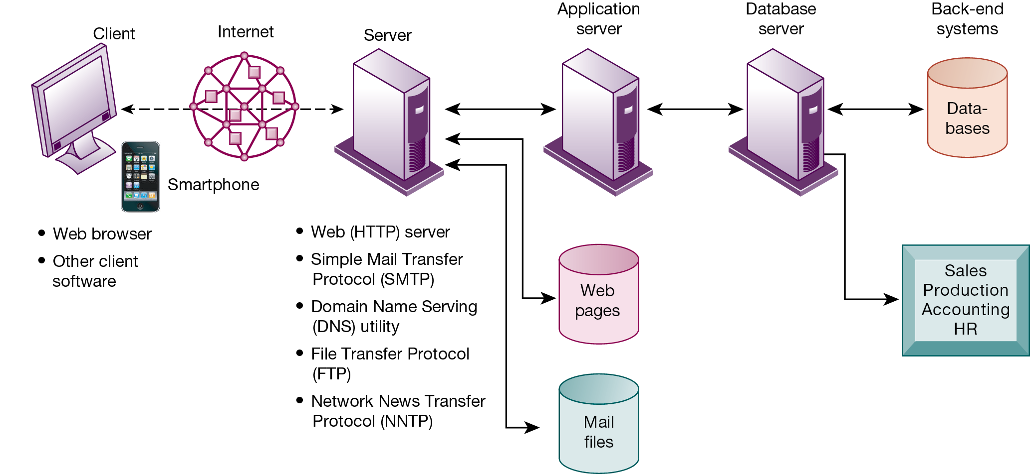
Figure 7.8 Client/Server Computing on the Internet
Notes:
Figure 7.8, Page 268.
Client computers running web browsers and other software can access an array of services on servers over the Internet. These services may all run on a single server or on multiple specialized servers.
This graphic looks at the services that an Internet server computer can offer: Websites (HTTP), e-mail (SMTP), file transfer (FTP), newsgroups (NNTP). It illustrates where on the path between client and backend systems these services lie.
A Diagram depicts computing on the Internet. In the diagram, the Internet reaches clients on computers and smartphones through web browsers and other client software. It also is accessed through web, h t t p, server, simple mail transfer protocol, or S M T P, domain name serving, or D N S, utility, file transfer protocol, or F T P, and network news transfer protocol, or N N T P. These servers communicate with application servers and also provide web pages and mail files. The application server communicates with a database server to reach back end servers, such as databases, as well as department functions such as sales, production, accounting, and H R.

Slide 28
Internet Services and Communication Tools (2 of 2)
Unified communications
Communications systems that integrate voice, data, e-mail, conferencing
Virtual private network (V P N)
Secure, encrypted, private network run over Internet
P P T P
Tunneling
Notes:
Students who have cable Internet telephones are using VoIP. Other popular technologies that use the Internet as a platform are VoIP, unified communications, and virtual private networks. Ask students what they think is the value to business is of each of these technologies.

Slide 29
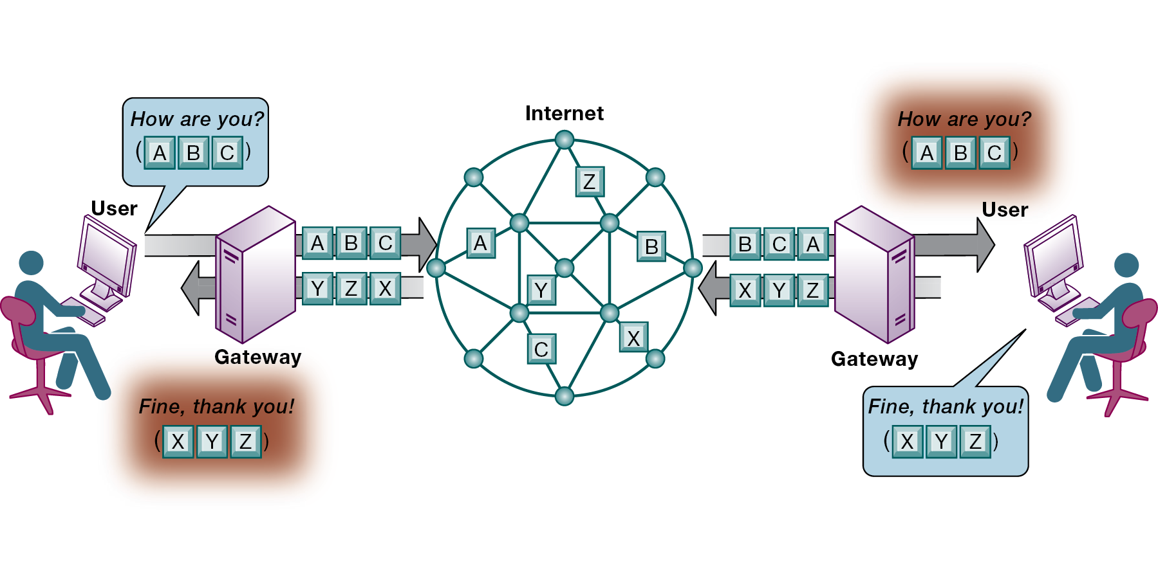
Figure 7.9 How Voice over I P Works
Notes:
Figure 7.9, Page 269.
A VoIP phone call digitizes and breaks up a voice message into data packets that may travel along different routes before being reassembled at the final destination. A processor nearest the call’s destination, called a gateway, arranges the packets in the proper order and directs them to the telephone number of the receiver or the IP address of the receiving computer.
This graphic shows how VoIP works. The voice messages are digitized and transported over the Internet in the same packet-switching method as traditional Internet data. Gateways are simply computers (network devices) that maintain the interface with the Internet in a firm.
Full description: A Diagram depicts the process of voice over I P. In the diagram, a user’s message of, How are you? Becomes three packets labeled, A, B, and C. Traveling through a gateway, these packets take separate paths via the Internet to reach a gateway where they are reassembled in the correct order for the intended user. The second user responds with the message, Fine, thank you! Which becomes three packets, X, Y, and Z. These packets travel as separate packets over the Internet and through the gateways to be reassembled to reach the original user.

Slide 30
Interactive Session: Management: Monitoring Employees on Networks: Unethical or Good Business?
Class discussion
Should managers monitor employee e-mail and Internet usage? Why or why not?
Describe an effective e-mail and web use policy for a company.
Should managers inform employees that their web behavior is being monitored? Or should managers monitor secretly? Why or why not?

Slide 31
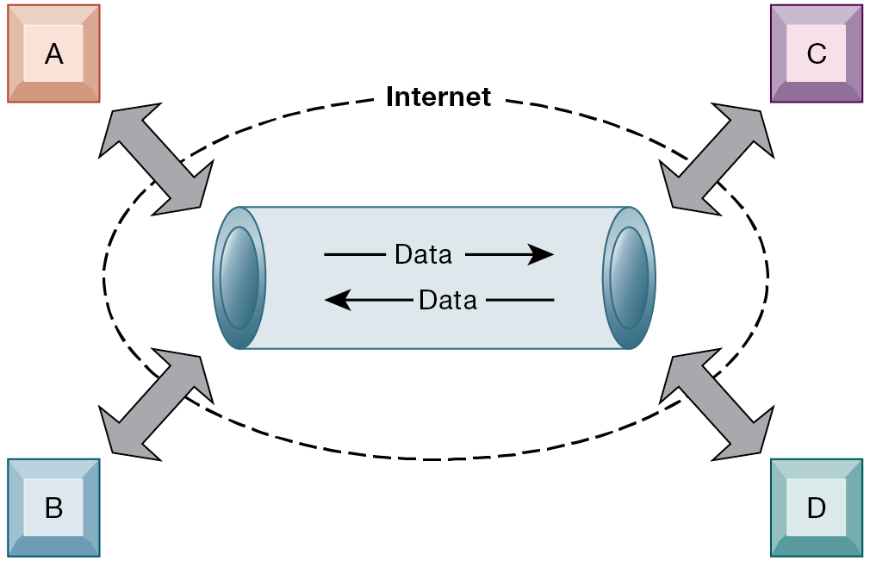
Figure 7.10 A Virtual Private Network Using the Internet
Notes:
Figure 7.10, Page 272.
This VPN is a private network of computers linked using a secure tunnel connection over the Internet. It protects data transmitted over the public Internet by encoding the data and wrapping them within the Internet protocol. By adding a wrapper around a network message to hide its content, organizations can create a private connection that travels through the public Internet.
This graphic illustrates how a virtual private network works. The rectangles A, B, C, and D represent different computers on the VPN. In a process
called tunneling, packets of data are encrypted and wrapped inside IP packets. By adding this wrapper around a network message to hide its content, business firms create a private connection that travels through the public Internet.

Slide 32
The Web
Hypertext
Hypertext Markup Language (H T M L)
Hypertext Transfer Protocol (H T T P):
Uniform resource locator (U R L):
http://www.megacorp.com/content/features/082602.html
Web servers
Software for locating and managing web pages
Notes:
This slide looks at one of the most popular services on the Internet, the web, and the main protocols enabling the web. The web is an interlinked connection of websites, which are collections of web pages linked to a home page. These pages are created using a text markup language call HTML, and transmitted to user’s web browsers by HTTP. Web page addresses (URLs) are composed of the domain name of the website and the file location of the individual web page. Ask students if any have created web pages using HTML, and if so, to describe what this is like. How have they made the web pages visible to others on the web? There is a learning track available online that shows students how to create web pages using basic HTML.

Slide 33
Searching for Information on the Web
Mobile search
Semantic search
Social search
Visual search
Intelligent agent shopping bots
Search engine marketing
Search engine optimization (S E O)
Notes:
This slide looks at how people find information of interest on the web. The primary method is through search engines, which today act as major portals to the web. Ask students where their initial points of entry are on the web, and how they find information they are interested in. Most will be Google users, but ask if they have looked at Bing, the Microsoft search engine that is showing some promise.
The text discusses how big the web is, in terms of pages. Google visited and indexed the content of more than an estimated 50 billion web pages in 2011, but this does not include the “deep web.” Other estimates point to “one trillion” web pages, but many of these are duplicates.

Slide 34
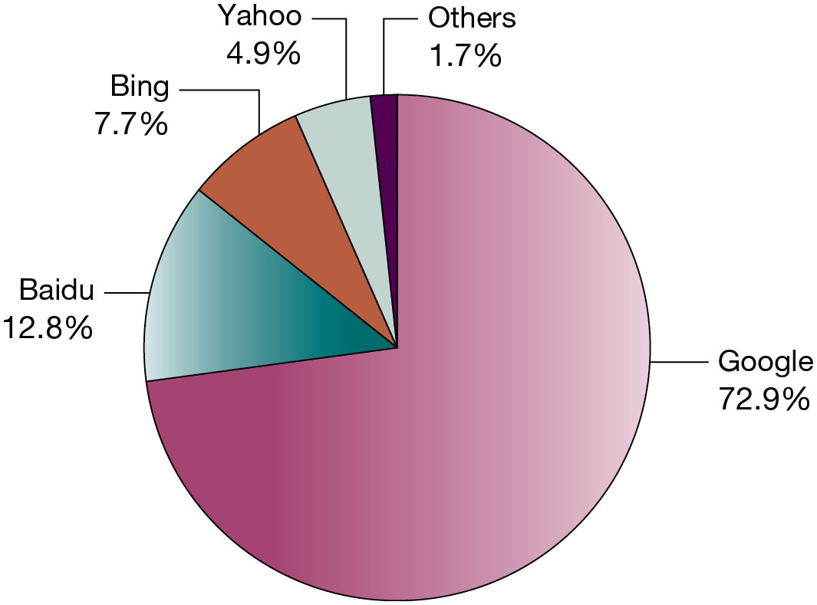
Figure 7.11 Top Desktop/Laptop Web Search Engines Worldwide
Notes:
Figure 7.11, Page 273.
Google is the most popular search engine.
Source: Based on data from Net Market Share, April 2018.
This graphic ranks the major search engines according to popularity, or percentage of total number of searches performed. Google is a clear favorite. Is this due to the superiority of their search engine results or does it involve other factors such as their clean interface, or their reach, which makes their ad platform more valuable to advertisers. Poll your class about the search engines they use.

Slide 35
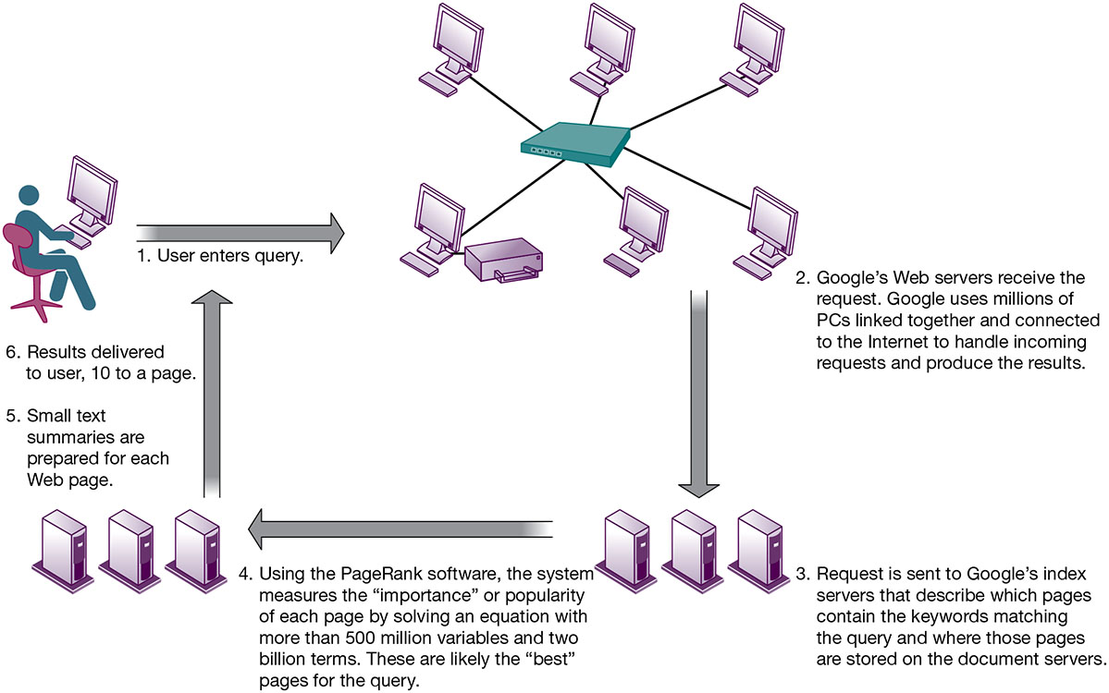
Figure 7.12 How Google Works
Notes:
Figure 7.12, Page 274.
The Google search engine is continuously crawling the web, indexing the content of each page, calculating its popularity, and storing the pages so that it can respond quickly to user requests to see a page. The entire process takes about half a second.
This graphic illustrates in a very high level diagram how Google works. At the foundation of Google’s search engine are two concepts—page ranking and the indexing of combinations of words. Ask students if they have a favorite search engine, and if so, why that search is their favorite. The reality of how Google actually works is the subject of many volumes, and is beyond the scope of this book.
Full description: A diagram shows how Google works. Step 1. User enters query. 2. Google’s Web servers receive the request. Google uses millions of P C's linked together and connected to the Internet to handle incoming requests and produce the results. 3. Request is sent to Google’s index servers that describe which pages contain the keywords matching the query and where those pages are stored on the document servers. 4. Using the Page Rank software, the system measures the, importance, or popularity of each page by solving an equation with more than 500 million variables and 2 billion terms. These are likely the, best, pages for the query. 5. Small text summaries are prepared for each Web page. Step 6. Results delivered to user, 10 to a page.

Slide 36
The Future Web
More tools to make sense of trillions of pages on the Internet
Pervasive web
Internet of Things (I o T)
Internet of People
App Internet
Increased cloud computing and S a a S
Ubiquitous mobile connectivity
Greater seamlessness of web as a whole
Notes:
The Internet of Things includes the idea that our cars, refrigerators, heaters and air conditioning units, along with all other appliances, and buildings, will be on the Internet.

Slide 37
Cellular Systems (1 of 2)
Competing standards
C D M A : United States only
G S M : Rest of world, A T&T, T-Mobile
Third-generation (3G) networks
144 K b p s
Suitable for e-mail access, web browsing
Notes:
This slide discusses the continuing revolution in wireless communication. Ask students what changes or improvements have happened in their cell phone service over the past two years. Have they purchased or upgraded a cell phone in that time, and if so, why? Most cell phone users today rely on 3G networks, a standard which first appeared in the early 2000s, and was improved upon over the last decade. 3G networks have mobile upload capacities of about 144 mbps, enough for email and some web browsing, but not videos. 4G networks started appearing in 2010 in the United States. They are also called LTE (Long Term Evolution) networks. 4G cell networks can be used for display of video on mobile devices with download speeds of about 100 mbps, and upload speeds of 50 mbps. How many students watch videos on their smartphones?

Slide 38
Cellular Systems (2 of 2)
Fourth-generation (4G) networks
Up to 100 Mbps
Suitable for Internet video
L T E and Wi Max
5G Networks
Gigabit capacity
Currently under development and early test deployments
Notes:
This slide discusses the continuing revolution in wireless communication. Ask students what changes or improvements have happened in their cell phone service over the past two years. Have they purchased or upgraded a cell phone in that time, and if so, why? Many flop phone users today rely on 3G networks, a standard which first appeared in the early 2000s, and was improved upon over the last decade. 3G networks have mobile upload capacities of about 144 mbps, enough for email and some web browsing, but not videos. 4G networks started appearing in 2010 in the United States. They are also called LTE (Long Term Evolution) networks. 4G cell networks can be used for display of video on mobile devices with download speeds of about 100 mbps, and upload speeds of 50 mbps. How many students watch videos on their smartphones?

Slide 39
Wireless Computer Networks and Internet Access (1 of 2)
Bluetooth (802.15)
Links up to 8 devices in 10-meter area using low-power, radio-based communication
Useful for personal networking (P A N s)
Wi-Fi (802.11)
Set of standards: 802.11
Used for wireless L A N and wireless Internet access
Use access points: device with radio receiver/transmitter for connecting wireless devices to a wired L A N
Notes:
This slide discusses the current standards in wireless networking. Ask students if they have any Bluetooth or wireless devices they use for computing, such as keyboards, earphones, or other. Note that in most Wi-Fi communications, wireless devices communicate with a wired LAN using an access point.

Slide 40
Wireless Computer Networks and Internet Access (2 of 2)
Hotspots: one or more access points in public place to provide maximum wireless coverage for a specific area
Weak security features
W i Max (802.16)
Wireless access range of 31 miles
Require W i M a x antennas
Notes:
This slide continues the discussion about wireless networking and Wi-Fi. Ask students if they have ever connected to the Internet through a hotspot at an airport, coffee shop, hotel, or other location. Are they aware of the security issues of using their smartphones to access the Internet at, say, Starbucks.
Ask students what other drawbacks, beside security, there are to Wi-Fi (roaming difficulties, interference). Note that wireless networks based on the upcoming 802.11n specification will solve interference problems by using multiple wireless antennas in tandem to transmit and receive data and technology to coordinate multiple simultaneous radio signals. What is this technology called? (MIMO).

Slide 41
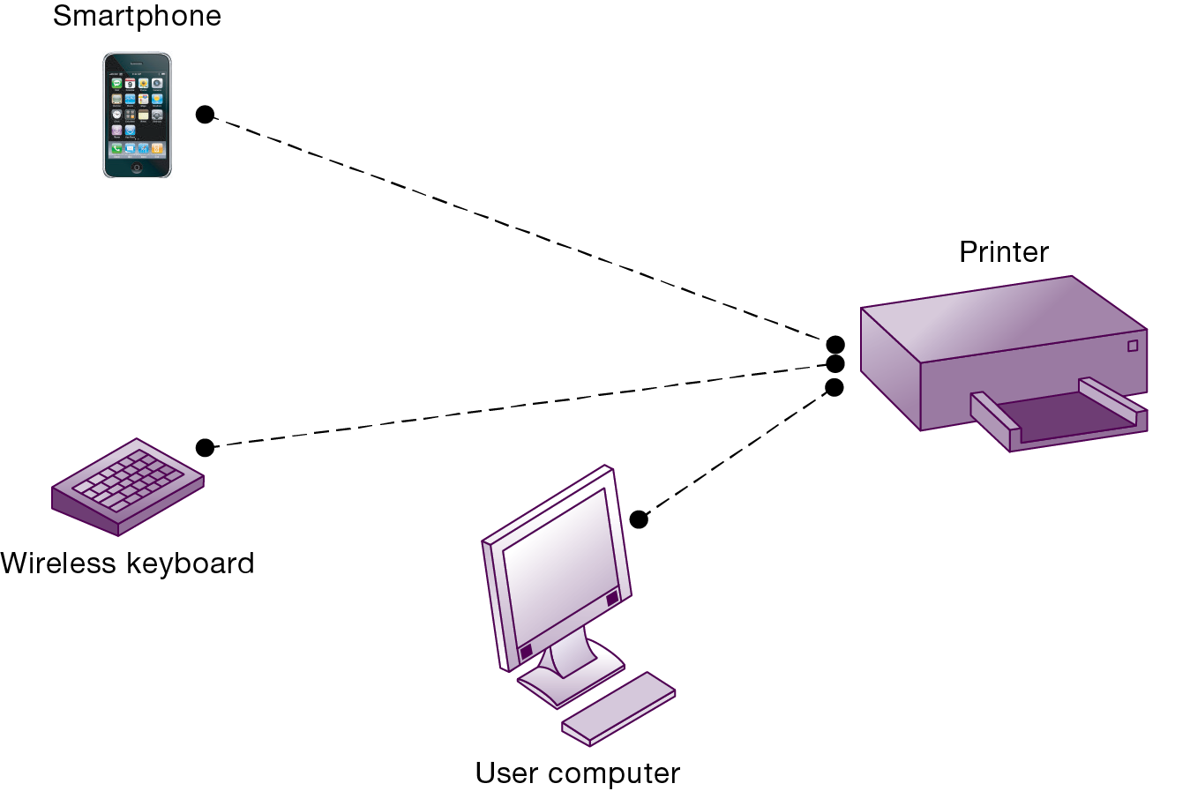
Figure 7.13 A Bluetooth Network (P A N)
Notes:
Figure 7.13, Page 280.
Bluetooth enables a variety of devices, including cell phones, smartphones, wireless keyboards and mice, PCs, and printers, to interact wirelessly with each other within a small, 30-foot (10-meter) area. In addition to the links shown, Bluetooth can be used to network similar devices to send data from one PC to another, for example.
This graphic illustrates the uses of Bluetooth for a PAN. Bluetooth connects wireless keyboards and mice to PCs or cell phones to earpieces without wires. Bluetooth has low-power requirements, making it appropriate for battery-powered handheld computers, and cell phones. Most cell phones today are Bluetooth enabled, allowing them to connect to other wireless devices (such as earphones) and PCs.

Slide 42
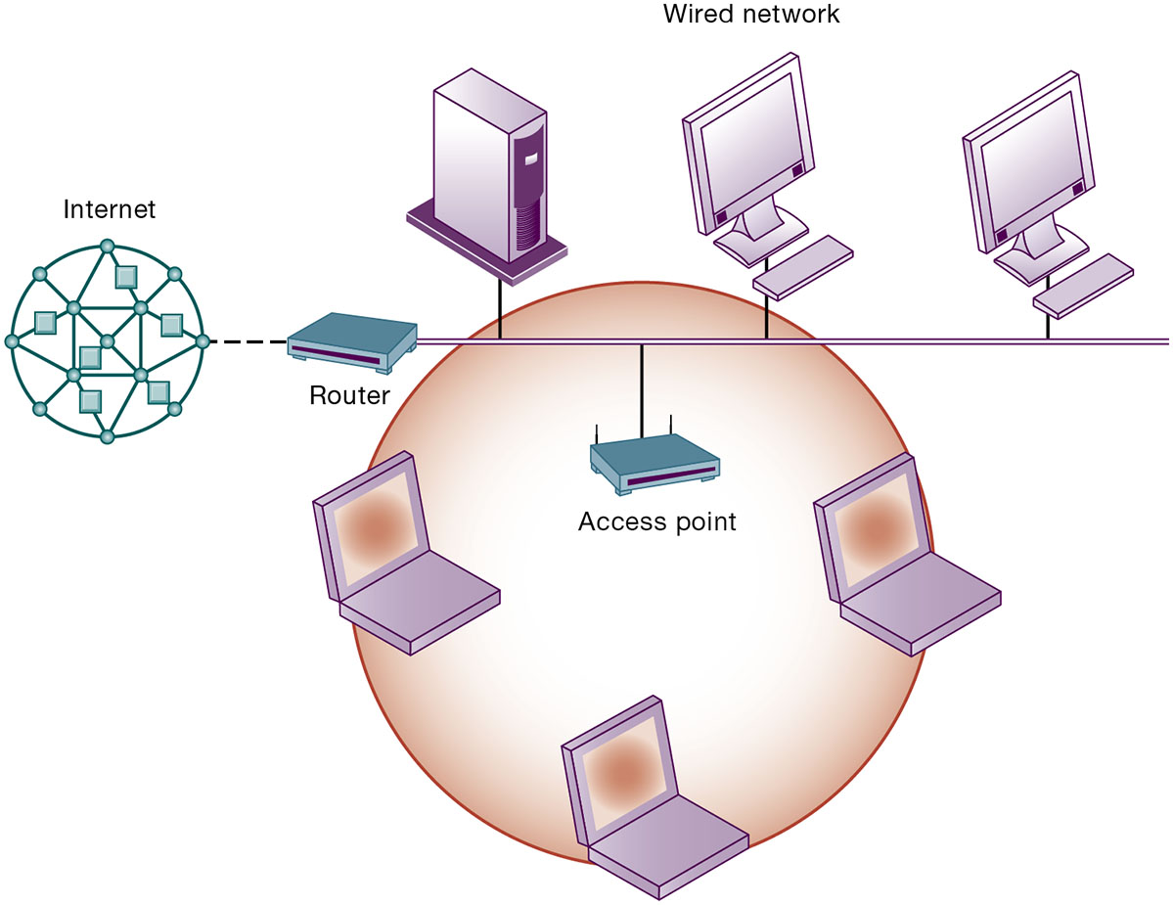
Figure 7.14 An 802.11 Wireless L A N
Notes:
Figure 7.14, Page 281.
Mobile laptop computers equipped with network interface cards link to the wired LAN by communicating with the access point. The access point uses radio waves to transmit network signals from the wired network to the client adapters, which convert them to data that the mobile device can understand. The client adapter then transmits the data from the mobile device back to the access point, which forwards the data to the wired network.
This graphic illustrates an 802.11 wireless LAN operating in infrastructure mode that connects a small number of mobile devices to a larger wired LAN. Most wireless devices are client machines. The servers that the mobile client stations need to use are on the wired LAN. The access point controls the wireless stations and acts as a bridge between the main wired LAN and the wireless LAN. (A bridge connects two LANs based on different technologies like your wireless network to your BluRay player so you can download Internet movies from Netflix and watch them on your TV). The access point also controls the wireless stations.

Slide 43
Radio Frequency Identification (R F I D)
Use tiny tags with microchips containing data about an item and location
Tag antennas to transmit radio signals over short distances to special R F I D readers
Common uses:
Automated toll-collection
Tracking goods in a supply chain
Reduction in cost of tags making R F I D viable for many firms
Notes:
This slide introduces one of two wireless technologies having a major impact on business, radio frequency ID. Ask students for examples of where RFID is used today. The text provides the example of Walmart using RFID to manage inventory and supply chains. Ask students how this works.

Slide 44
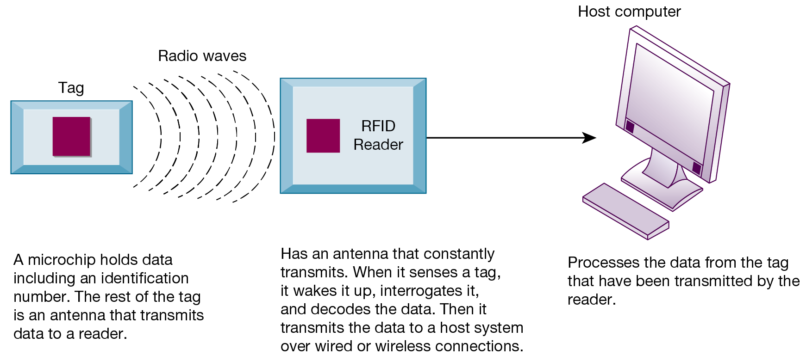
Figure 7.15 How R F I D Works
Notes:
Figure 7.15, Page 283.
RFID uses low-powered radio transmitters to read data stored in a tag at distances ranging from 1 inch to 100 feet. The reader captures the data from the tag and sends them over a network to a host computer for processing.
This graphic illustrates how RFID works. Ask students if RFID potentially poses any ethical problems. For example, if your jeans have a built in RFID chip, it’s easy to track your movements. Likewise if your student ID card has an RFID chip.
Full description: A Diagram depicts how an R F I D works. The first component is The tag. A microchip that holds data including an identification number. The rest of the tag is an antenna that transmits data to a reader. The tag communicates via radio waves to The R F I D reader, which Has an antenna that constantly transmits. When it senses a tag, it wakes it up, interrogates it, and decodes the data. Then it transmits the data to a host system over wired or wireless connections. The host computer Processes the data from the tag that have been transmitted by the reader.

Slide 45
Wireless Sensor Networks (W S N s)
Networks of hundreds or thousands of interconnected wireless devices
Used to monitor building security, detect hazardous substances in air, monitor environmental changes, traffic, or military activity
Devices have built-in processing, storage, and radio frequency sensors and antennas
Require low-power, long-lasting batteries and ability to endure in the field without maintenance
Major sources of “Big Data” and fueling “Internet of Things”
Notes:
This slide introduces a second wireless technology having a major impact on business, wireless sensor networks. Note that the wireless sensors are linked into an interconnected network that routes the data to a computer for analysis.

Slide 46
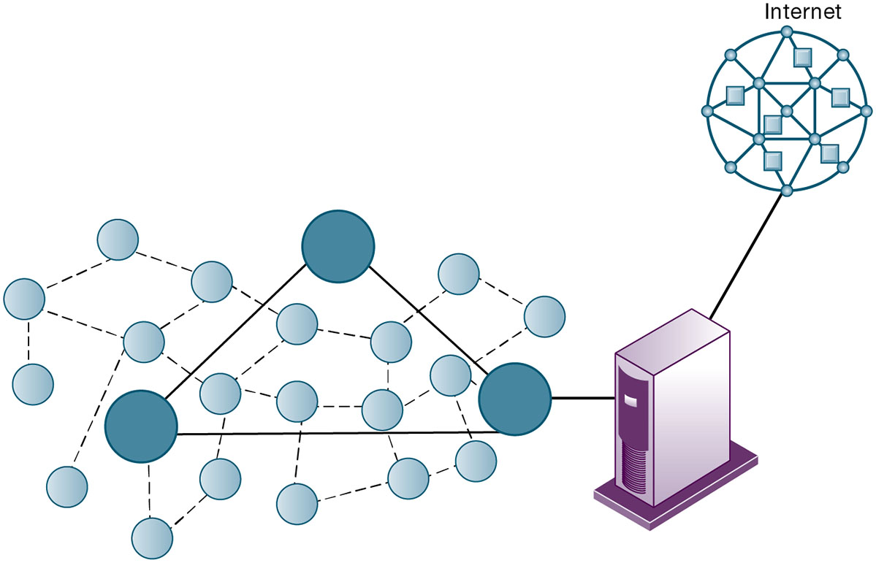
Figure 7.16 A Wireless Sensor Network
Notes:
Figure 7.16, Page 284
The small circles represent lower-level nodes, and the larger circles represent high-end nodes. Lower-level nodes forward data to each other or to higher-level nodes, which transmit data more rapidly and speed up network performance.
This graphic illustrates the lower level nodes and higher level nodes at work in a wireless sensor network. Note that the server that data from the sensors is sent to acts as a gateway to a network based on Internet technology.

Slide 47
How Will M I S Help My Career?
The Company: A1 Western Car Dealers
Position Description: Automotive digital advisor
Job Requirements
Interview Questions
Author Tips

Slide 48

Copyright
This work is protected by United States copyright laws and is provided solely for the use of instructors in teaching their courses and assessing student learning. Dissemination or sale of any part of this work (including on the World Wide Web) will destroy the integrity of the work and is not permitted. The work and materials from it should never be made available to students except by instructors using the accompanying text in their classes. All recipients of this work are expected to abide by these restrictions and to honor the intended pedagogical purposes and the needs of other instructors who rely on these materials.

